Slide 1


Sebastian Korab
19th December 2023

Slide 2

Outline
Executive Summary
Introduction
Methodology
Results
Conclusion
Appendix

Slide 3
Executive Summary
Summary of methodologies
Summary of all results

Slide 4
Introduction
Project background
Technological progress has led to growing demand in satellites. As government led programs come along with higher costs per rocket launch, SpaceX has defined the commercialized cost-efficient rocket launches as one of its goals.
SpaceX advertises Falcon 9 rocket launches on its website with a cost of 62 million dollars; other providers cost upward of 165 million dollars each, much of the savings is because SpaceX can reuse the first stage. Therefore if we can determine if the first stage will land, we can determine the cost of a launch. This information can be used if an alternate company wants to bid against SpaceX for a rocket launch.
Goal
This project aims at analyzing historical data from the SpaceX launches in order to identify drivers, such as launch site or targeted orbits, for positive outcomes (i.e. launches with successful landings).
Based on the exploratory data analysis we will build a model for the prediction of a positive landing.

Slide 5

Section 1

Slide 6
Methodology
Executive Summary
Data collection methodology:
Data was collected based on SpaceX REST API and web scraping
Perform data wrangling
Data was filtered, missing values were managed and one-hot-encoding was applied
Perform exploratory data analysis (EDA) using visualization and SQL
Perform interactive visual analytics using Folium and Plotly Dash
Perform predictive analysis using classification models
After segregation in training and test sets, predictive models were built. Different methods and its results were compared to each other.

Slide 7
Data Collection
Data was collected based on SpaceX REST API and web scraping
SpaceX REST API
- requesting and parsing the SpaceX launch data using the GET request
- decoding the response by the use of the .json()-function
- filtering the dataframe, so that only Falcon 9 launches will remain
Web Scraping
- requesting Falcon 9 launch data from Wikipedia
- creation of a `BeautifulSoup` object from the HTML `response`
- extracting all column/variable names from the HTML header
- creation of a dataframe by parsing the launch HTML tables

Slide 8
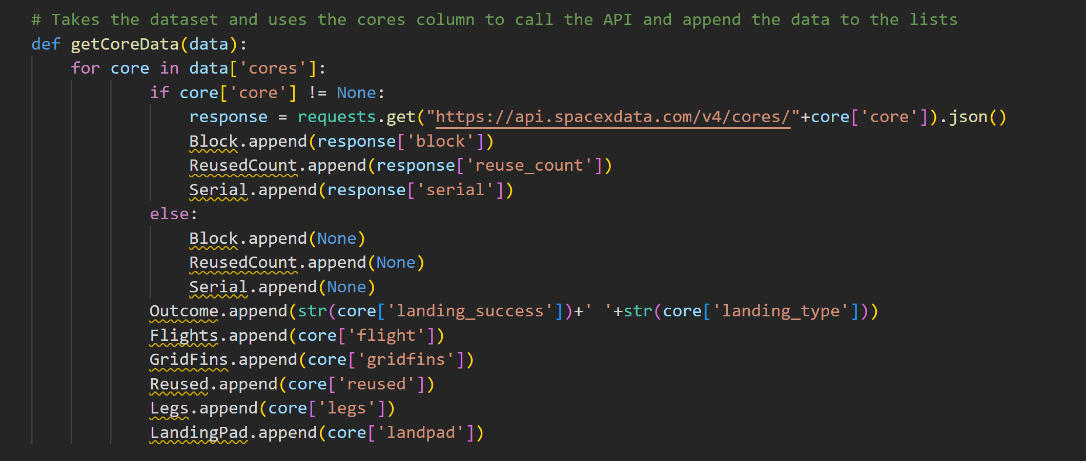
Data Collection – SpaceX API
requesting and parsing the SpaceX launch data, the response got encoded and the dataframe got filtered I order to keep only Falcon 9 launches
GitHub URL to the SpaceX API calls notebook:
https://github.com/YoSebastian/SebastianKorab_SpaceY_IBM_DataScience_Capstone/blob/main/EDIT_jupyter-labs-spacex-data-collection-api.ipynb

Slide 9
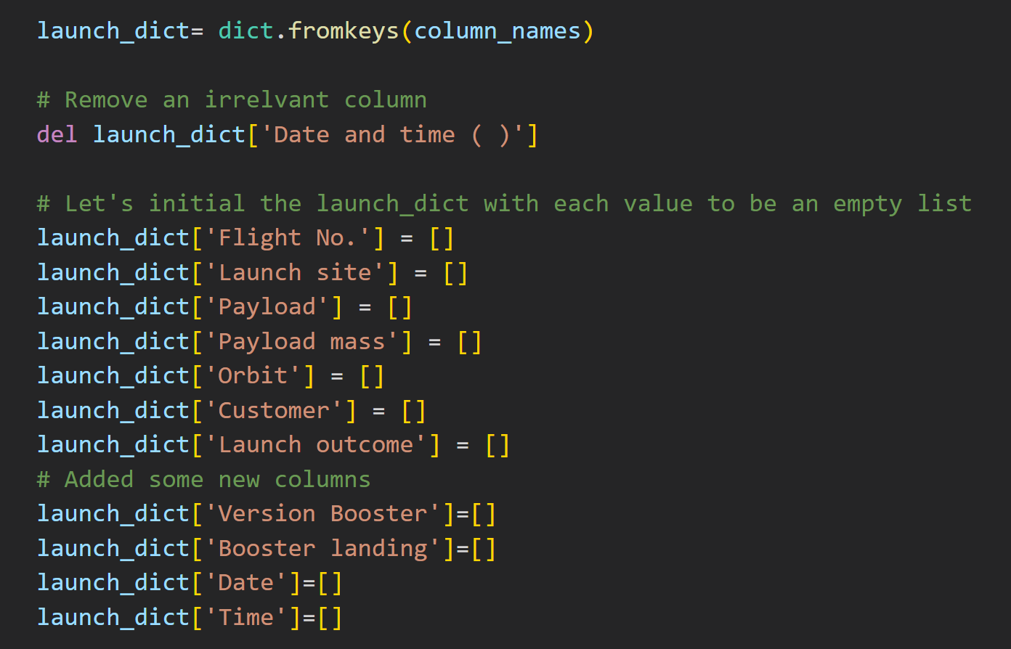
Data Collection - Scraping
requesting Falcon 9 launch data, creation of a `BeautifulSoup` and a dataframe by parsing the launch HTML tables
GitHub URL to the Web Scraping notebook:
https://github.com/YoSebastian/SebastianKorab_SpaceY_IBM_DataScience_Capstone/blob/main/EDIT_jupyter-labs-webscraping.ipynb

Slide 10
Data Wrangling
exploratory data analysis was conducted and training labels were determined
calculation of:
the number of launches on each site
the number and occurrence of each orbit
the number and occurrence of mission outcome of the orbits
creating a landing outcome label
GitHub URL to the data wrangling notebooks:
https://github.com/YoSebastian/SebastianKorab_SpaceY_IBM_DataScience_Capstone/blob/main/EDIT_labs-jupyter-spacex-Data%20wrangling.ipynb

Slide 11
EDA with Data Visualization
Visualization of:
the relationship between Flight Number and Launch Site
the relationship between Payload and Launch Site
the relationship between success rate of each orbit type
the relationship between Flight Number and Orbit type
the relationship between Payload and Orbit type
the launch success yearly trend
GitHub URL to the EDA with data visualization notebooks:
https://github.com/YoSebastian/SebastianKorab_SpaceY_IBM_DataScience_Capstone/blob/main/EDIT_jupyter-labs-eda-dataviz.ipynb

Slide 12
EDA with SQL
SQL queries leading to:
the names of the unique launch sites in the space mission
5 records where launch sites begin with the string 'CCA’
total payload mass carried by boosters launched by NASA (CRS)
average payload mass carried by booster version F9 v1.1
the date when the first successful landing outcome in ground pad was achieved
the names of the boosters which have success in drone ship and have payload mass greater than 4000 but less than 6000
the total number of successful and failure mission outcomes
names of the booster versions which have carried the maximum payload mass
ranking the count of landing outcomes
GitHub URL to the EDA with SQL notebook:
https://github.com/YoSebastian/SebastianKorab_SpaceY_IBM_DataScience_Capstone/blob/main/EDIT_jupyter-labs-eda-sql-coursera_sqllite.ipynb

Slide 13
Build an Interactive Map with Folium
Added to folium map:
circles for all launch sites on a map
colored markers the success(green)/failed(red) launches for each site on the map
lines for the distances between a launch site to its proximities
The added items provide an overview of the relevant launch locations, success rates and resulting risks from failed launches affecting proximities, such as cities or highways
GitHub URL to the Folium interactive map notebook:
https://github.com/YoSebastian/SebastianKorab_SpaceY_IBM_DataScience_Capstone/blob/main/EDIT_lab_jupyter_launch_site_location.ipynb

Slide 14
Build a Dashboard with Plotly Dash
Following plots/graphs were added to a dashboard:
dropdown list to enable Launch Site selection
pie chart to show the total successful launches count for all sites
slider to select payload range
scatter chart to show the correlation between payload and launch success
GitHub URL to the Plotly Dash Python file:
https://github.com/YoSebastian/SebastianKorab_SpaceY_IBM_DataScience_Capstone/blob/main/spacex_dash_app.py

Slide 15
Predictive Analysis (Classification)
performed EDA and determined training labels
created a column for the class (successful mission/failure)
standardized the data
split into training data and test data
found the best hyperparameters for SVM, Classification Trees and Logistic Regression
found the method performs best using test data
GitHub URL to the Predictive Analysis Python file:
https://github.com/YoSebastian/SebastianKorab_SpaceY_IBM_DataScience_Capstone/blob/main/EDIT_SpaceX_Machine_Learning_Prediction_Part_5.jupyterlite.ipynb

Slide 16
Results
Exploratory data analysis results
Interactive analytics demo in screenshots
Predictive analysis results

Slide 17

Section 2

Slide 18
Flight Number vs. Launch Site
Show a scatter plot of Flight Number vs. Launch Site
Show the screenshot of the scatter plot with explanations

Slide 19
Payload vs. Launch Site
Show a scatter plot of Payload vs. Launch Site
Show the screenshot of the scatter plot with explanations

Slide 20
Success Rate vs. Orbit Type
Show a bar chart for the success rate of each orbit type
Show the screenshot of the scatter plot with explanations

Slide 21
Flight Number vs. Orbit Type
Show a scatter point of Flight number vs. Orbit type
Show the screenshot of the scatter plot with explanations

Slide 22
Payload vs. Orbit Type
Show a scatter point of payload vs. orbit type
Show the screenshot of the scatter plot with explanations

Slide 23
Launch Success Yearly Trend
Show a line chart of yearly average success rate
Show the screenshot of the scatter plot with explanations

Slide 24
All Launch Site Names
Find the names of the unique launch sites
Present your query result with a short explanation here

Slide 25
Launch Site Names Begin with 'CCA'
Find 5 records where launch sites begin with `CCA`
Present your query result with a short explanation here

Slide 26
Total Payload Mass
Calculate the total payload carried by boosters from NASA
Present your query result with a short explanation here

Slide 27
Average Payload Mass by F9 v1.1
Calculate the average payload mass carried by booster version F9 v1.1
Present your query result with a short explanation here

Slide 28
First Successful Ground Landing Date
Find the dates of the first successful landing outcome on ground pad
Present your query result with a short explanation here

Slide 29
Successful Drone Ship Landing with Payload between 4000 and 6000
List the names of boosters which have successfully landed on drone ship and had payload mass greater than 4000 but less than 6000
Present your query result with a short explanation here

Slide 30
Total Number of Successful and Failure Mission Outcomes
Calculate the total number of successful and failure mission outcomes
Present your query result with a short explanation here

Slide 31
Boosters Carried Maximum Payload
List the names of the booster which have carried the maximum payload mass
Present your query result with a short explanation here

Slide 32
2015 Launch Records
List the failed landing_outcomes in drone ship, their booster versions, and launch site names for in year 2015
Present your query result with a short explanation here

Slide 33
Rank Landing Outcomes Between 2010-06-04 and 2017-03-20
Rank the count of landing outcomes (such as Failure (drone ship) or Success (ground pad)) between the date 2010-06-04 and 2017-03-20, in descending order
Present your query result with a short explanation here

Slide 34

Section 3

Slide 35
<Folium Map Screenshot 1>
Replace <Folium map screenshot 1> title with an appropriate title
Explore the generated folium map and make a proper screenshot to include all launch sites’ location markers on a global map
Explain the important elements and findings on the screenshot

Slide 36
<Folium Map Screenshot 2>
Replace <Folium map screenshot 2> title with an appropriate title
Explore the folium map and make a proper screenshot to show the color-labeled launch outcomes on the map
Explain the important elements and findings on the screenshot

Slide 37
<Folium Map Screenshot 3>
Replace <Folium map screenshot 3> title with an appropriate title
Explore the generated folium map and show the screenshot of a selected launch site to its proximities such as railway, highway, coastline, with distance calculated and displayed
Explain the important elements and findings on the screenshot

Slide 38

Section 4

Slide 39
<Dashboard Screenshot 1>
Replace <Dashboard screenshot 1> title with an appropriate title
Show the screenshot of launch success count for all sites, in a piechart
Explain the important elements and findings on the screenshot

Slide 40
<Dashboard Screenshot 2>
Replace <Dashboard screenshot 2> title with an appropriate title
Show the screenshot of the piechart for the launch site with highest launch success ratio
Explain the important elements and findings on the screenshot

Slide 41
<Dashboard Screenshot 3>
Replace <Dashboard screenshot 3> title with an appropriate title
Show screenshots of Payload vs. Launch Outcome scatter plot for all sites, with different payload selected in the range slider
Explain the important elements and findings on the screenshot, such as which payload range or booster version have the largest success rate, etc.

Slide 42

Section 5

Slide 43
Classification Accuracy
Visualize the built model accuracy for all built classification models, in a bar chart
Find which model has the highest classification accuracy

Slide 44
Confusion Matrix
Show the confusion matrix of the best performing model with an explanation

Slide 45
Conclusions
Point 1
Point 2
Point 3
Point 4
…

Slide 46
Appendix
Include any relevant assets like Python code snippets, SQL queries, charts, Notebook outputs, or data sets that you may have created during this project

Slide 47


